Slide 1



G5- CINEMAXX
The Big Screen Experience!!
Presented By G5 Team

Slide 2

Introduction
G5 Cinemax Company Limited has observed the trend of major corporations investing in original video content and aims to establish its own competitive movie studio.
As the directors/heads lack existing industry expertise, they mandated G5-Moringa Data Enthusiasts to analyze current box office performance data to identify the most successful film genres and trends.
The G5-Moringa Data Enthusiasts will then synthesize this analysis into a strategic recommendations report to guide the studio head's decision-making on what types of films to produce which will be most profitable and have high ROI.

Slide 3

Overview
Strategy: The G5 - Data Enthusiasts group stipulated the G5 Cinemax Studio Strategy which its main objective is to analyze the box office performance data and provide actionable insights to guide the studio’s content creation strategy.

Slide 4

Business Understanding
The core business problem is one of de-risking market entry. G5 Cinemax is a new player with no experience in film production.
The goal is not just to identify what is "popular," but to identify the most financially sound and strategically viable paths to success. Key business questions include:
Profitability: Which genres yield the highest Return on Investment (ROI), not just the highest revenue?
Audience Appeal: Which genres have the strongest domestic vs. international (worldwide) appeal?
Strategic Fit: What is the optimal balance between high-budget "tentpole" films and lower-budget, high-ROI projects?
Critical Mass: Is there a correlation between a film's popularity (votes, rating) and its financial success?
Success Metric: Clear recommendations on genre, budget, and release strategy.

Slide 5
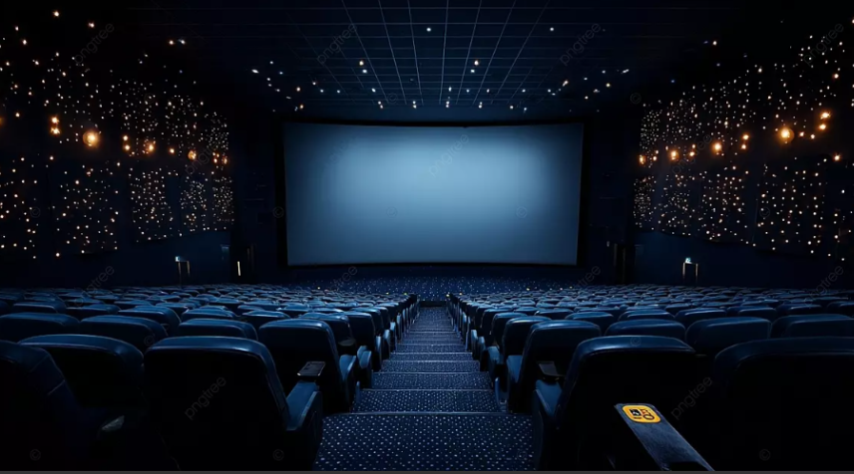
Data Understanding
The team analyzed all the data sets to understand how the data seated. The data sets reviewed were:
Box Office Mojo,
IMDB,
Rotten Tomatoes,
TheMovieDB
And The Numbers.
The objective of data understanding was to keenly select the data set/s which would bring out the best data driven analytical approach by picking the most important fields to enable the analysis statistically.
These fields included;
Identifiers, Film Metadata e.g genres, Audience & Critical Reception e.g computed metrics and Derived/Engineered Features e.g log_numvotes, combined_score etc.

Slide 6
Data Preparation
This phase involves cleaning and transforming the raw data into a reliable analysis-ready dataset.
Key Preparation Steps:
Handling Missing Values: Dropping rows with critical missing financial data
Data Type Conversion: Ensuring production_budget_num, domestic_gross_num, and worldwide_gross_num are stored as numeric integers, not strings.
Genre Standardization: The genres field is likely a pipe-separated string (e.g., "Action|Adventure|Sci-Fi"). This will be split to create a list of genres for each movie, enabling analysis by individual genre.
Outlier Treatment: Using techniques like winsorization (as seen in runtime_winsorized) to cap extreme values in financial data and runtimes that could skew averages.
Calculating Key Metrics: Creating the essential roi_num and profit_num columns if not already present.
Filtering: Focusing on a modern era (e.g., films from 2010 onwards) to ensure recommendations reflect current market trends.
After the data preparation process, the team identified three data sets which were combined, and a clean data set was generated named: finalcombined.csv which contained all the important fields to aid the statistical analysis.

Slide 7

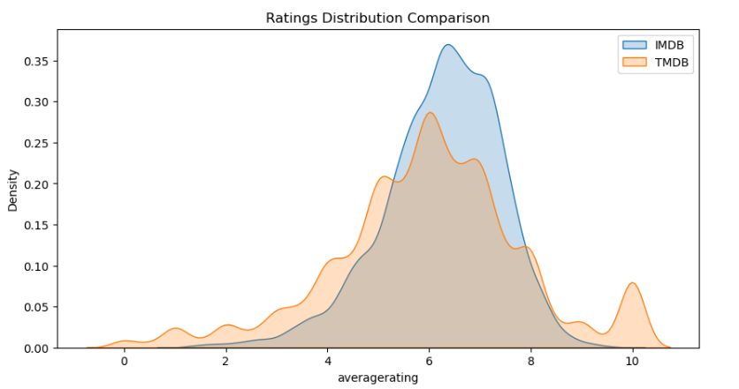
Data Analysis
This phase involves analysis steps done on the selected dataset and test hypotheses to drive strategic decisions.
Checking The correlation between ratings for the combined data sets.
The insights arrived on this :
There is high correlation between the ratings i.e when IMDB ratings are high, the corresponding TMDB ratings are high as well

Slide 8

Checking the Correlations
Checking the Correlations on Ratings and Popularity - Visualized
Key Insights from the Heatmap
1. There is a moderate strong correlation (0.67) between IMDB Average rating and TMDB Average rating.
Correlation = 0.67 → Movies rated high on IMDb tend to also be rated high on TMDB
2. Correlation on Ratings against Popularity -Weak correlation (0.16 – 0.20) → A highly rated movie is not necessarily popular.
3. Popularity drives audience engagement - More popular movies tend to attract more votes. Popularity and audience size move together.

Slide 9

Interpretations based on Correlation:
Overall Conclusion on correlations:
Ratings (IMDb/TMDB) and popularity are not strongly linked — quality (ratings) does not guarantee popularity.
Popularity and number of votes are connected, indicating mass reach drives audience participation.
IMDb and TMDB ratings align well but still leave room for differences across platforms.
Business Implication: Focus on both quality and mass appeal — good ratings build credibility, but popularity (marketing, distribution, trends) drives audience size and revenue

Slide 10
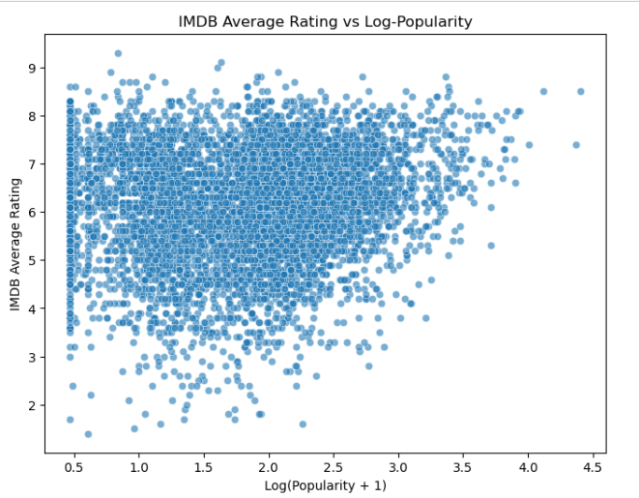
Additional Visualizations

Slide 11
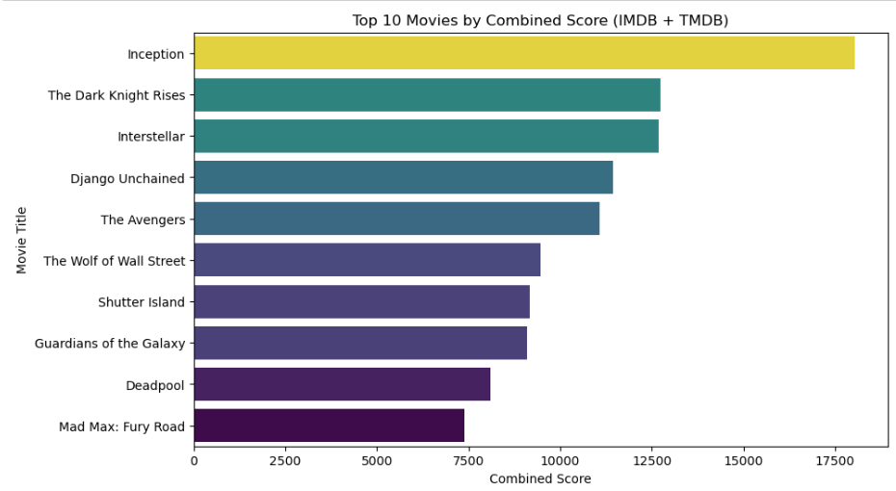
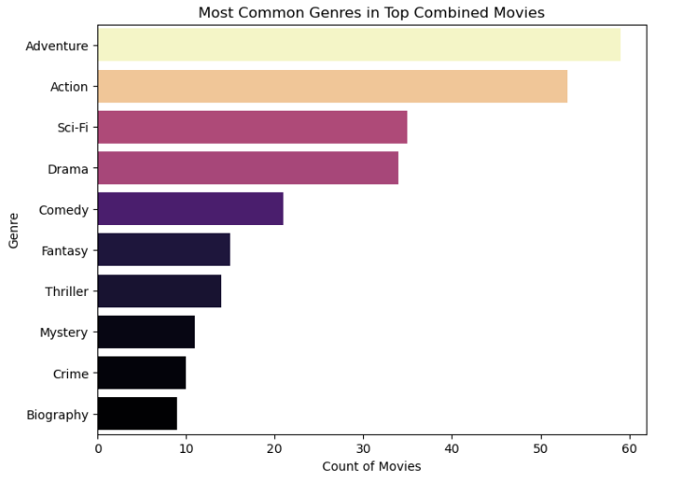
Visualizations

Slide 12
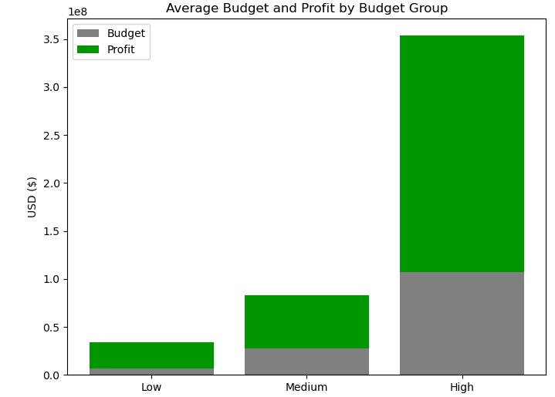
Checking average budget vs. profit across groups
Interpretation :
High –budget movies generate the largest absolute profits, but they also carry higher financial risk since ROI is lower
Low-budget movies have higher ROI(they make more per dollar invested), but profits are smaller in absolute terms.
Recommendations: A portfolio mix approach(Mix low and high) reduces risk while capturing upside potential.

Slide 13
Interpretation of the visualizations
Interpretation: Top 10 Movies by Combined Score (IMDB + TMDB)
Inception dominates the ranking with the highest combined score (≈18,000), clearly outperforming the rest.
The Dark Knight Rises and Interstellar follow closely, both above 12,000 combined score, showing strong popularity and ratings across both platforms.
Django Unchained and The Avengers occupy the middle tier with scores between 11,000 – 12,000, reflecting broad audience appeal.
Movies like The Wolf of Wall Street, Shutter Island, and Guardians of the Galaxy are in the 9,000 – 10,000 range, indicating solid but slightly lower combined influence.
Deadpool and Mad Max: Fury Road close the top 10 list with 7,000 – 8,000 combined score, still strong but trailing the leaders.
The biggest gap is between Inception and the second-highest (The Dark Knight Rises), suggesting Inception had both exceptional ratings and wide popularity.
Christopher Nolan’s films (Inception, Interstellar, The Dark Knight Rises) dominate the top, showing how his works consistently achieve high critical acclaim and popularity across platforms.

Slide 14
Business Conclusions and Recommendations
From the critical data set analysis and visualizations, the business insights are concluded as below.
For G5-Cinemaxx movie studio to have the best profitable ventures in the new movie business, they need to consider;
Adventure & Action blockbusters (broad, global appeal) – Have better ratings and global appeal which will translate to higher returns.
Sci-Fi and Drama (satisfy demand for imaginative as well as deep storytelling).
Consider blending Adventure + Sci-Fi or Action + Drama for maximum impact.
A portfolio mix approach(Mix low and high budget movies) reduces risk while capturing upside potential as displayed in the visualization under ROI.

Slide 15

AOBS

Slide 16
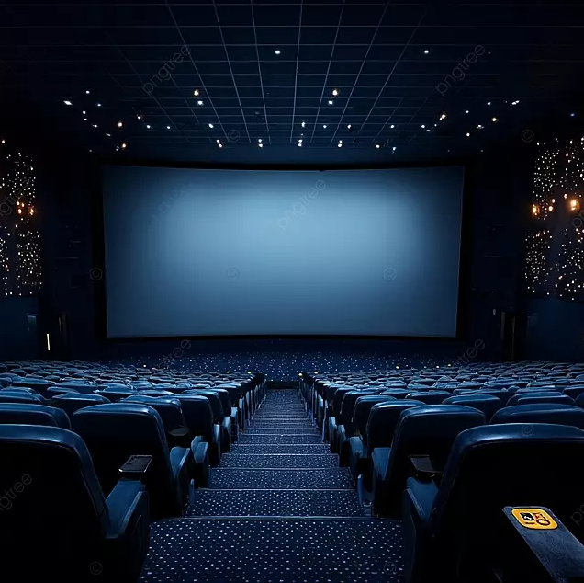
THANK YOU!!

